Slide 1
E Voting System Using Blockchain And Face Recognition

Slide 2
ABSTRACT
. The proposed system comprises three main sections: admin, voter, and candidate. The admin section authorizes the entry of voter and candidate information into a database. Voter registration involves the collection of facial features, while candidate registration requires basic information to create a database. During the voting process, a live camera is used to identify voters based on their facial features. The voter's eligibility is verified using the Facenet classification method, and if eligible, a unique voter ID block is added to the Blockchain. The voter ID block is hashed with SHA-512, making it impossible to tamper with the immutable records on the Blockchain.

Slide 3
INTRODUCTION
Across democracy, electoral protection is an trouble of country wide security. The laptop safety area has been operating at the possibilities of digital voting machine, with an aim of decreasing the fee of election and growing the safety of the election. From the start of the democratic elections, the voting machine become primarily based on pen and paper. Instead of pen and paper currently the Indian election makes use of evm machines,that are liable to vote casting fraud and device tampering. Electronic voting machine are taken into consideration invalid and anybody with bodily get entry to that device can tamper with the gadget ,as a result affecting all votes casted. Enter blockchain era. A blockchain is a disbursed, immutable, incontrovertible, public ledger.
This new technology works thru 4 foremost capabilities:
(i) The Blockchain ledger is distributed and no single birthday celebration controls it:the allotted ledger and no unmarried point of failure.
(ii) Once a transaction is delivered to the ledger it can't be edited or deleted.

Slide 4
Problem statement
The traditional method of conducting elections is often susceptible to human errors and fraudulent practices, which can undermine the legitimacy of the electoral process.
The use of facial recognition technology in the field of voting has gained significant attention in recent years due to its potential to improve the accuracy and security of the voting process.
However, existing facial recognition-based voting systems have several limitations, such as low accuracy rates, susceptibility to spoofing attacks, and lack of scalability.

Slide 5
Objective
The primary goal of electronic voting technology is to speed up ballot counting, lower the cost of paying staff to physically count ballots, and improve accessibility for voters with disabilities.
This can be accomplished by planning and creating a software framework for voter registration, election voting, real-time election results collation and monitoring, and primarily for remote voter access to elections.
Research and put into practice a security method that will be used to guarantee that votes submitted in the system won't be compromised and that no external attack would be encountered, which will be guaranteed by blockchain technology.

Slide 6
Aim of project
The objective of this project is to develop a face-based voting system using OpenCV and FaceNet. It aims to provide a secure and efficient way of verifying voters' identities using facial recognition technology. The system will capture images of the voters' faces and compare them to a database of registered voters using the FaceNet algorithm and generate hash key
. The system will also prevent fraud by ensuring that each voter can only vote once. The ultimate goal is to improve the voting experience by eliminating long wait times and providing a more convenient and secure way for citizens to exercise their right to vote with block chain voting.

Slide 7
Limitations
It is a time consuming process and also requires a lot of resources to conduct voting process.
Manual Process
There are many drawbacks to this process, including lack of transparency, low voter participation, vote tampering, distrust of electoral officials, delays in results, and, most importantly, security concerns

Slide 8
EXISTING SYSTEM
Voters cast their votes by simply depositing their ballots in sealed boxes distributed across the electoral circuits around a given country.
After ending of election period the boxes which contains of ballot control unit are opened and votes are counted manually in presence of the certified officials appointed by election commision.

Slide 9
PROPOSED SYSTEM
The proposed blockchain voting system considers all requirements for voting and is designed generally for any elections e.g. president, student parliament, etc. The system allows more round elections and preferably uses a public blockchain. The public blockchain can be replaced by other types of blockchain but the stored data (votes) have to be easily verified by any user. The user represents any observer who is interested in the blockchain voting. In our proposed system we identify three main roles: vote publisher; key authority; and voter. These three roles can represent an organization, a company, or a user. The roles vote publisher and key authority can be grouped to one role due to that they can be the same organization or person. The voter attends the elections depending on vote configuration. The configuration of the votes is performed by the vote publisher and is included in the smart contract. The vote publisher has to know all cipher keys before publishing the smart contract. The close collaboration between the vote publisher and the key authority is required. The key authority creates and distributes all cipher keys to a voter and vote publisher. The distributing channel has to be secured and should not be vulnerable to any 3rd party.

Slide 10
Advantages
1)Fast and Accurate
2)High Security
3)Reduction of queues and waiting times.
4)Minimization of human errors in voter identification.

Slide 11
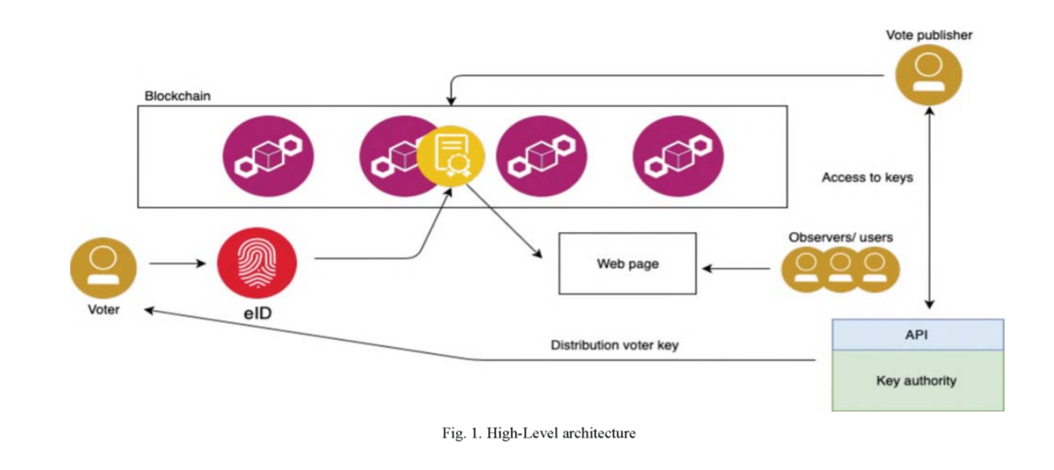
ARCHITECTURE

Slide 12
MODULES
ADMIN
USER
In this project we are using public python Blockchain API’s to store and manage voting data as Blockchain provides secure and tamper proof of data storage and to implement this project we have designed following modules.
Admin module: this user responsible to add new party and candidate details and can view party details and vote count. Admin login to system by using username as ‘admin’ and password as ‘admin’.

Slide 13
User Module: this user has to signup with the application by using username as his ID and then upload his face photo which capture from webcam. After registering user can go for login which validate user id and after successful login user can go for cast vote module which execute following functionality,
Face Recognition Module: Using this module new users images are captured and stored in system using face recognition Facenet algorithm is used to match faces while login process.
Block Chain Module: Using this module bock chain hash key is generated for each voter based on his name and id and stored in text file. Which is used for voting verification if once voter votes block chain will verify.

Slide 14
FaceNet ALgorithm
The implementation details for a smart voting system through face recognition using django, the FaceNet algorithm,
1)Face Detection and Recognition:
The system should capture the face image of the voter using a webcam.
The Face Net algorithm should be used to extract the facial features of the voter.
These facial features should be compared with the stored features in the dataset to verify the identity of the voter.

Slide 15
Feasibility study
The functional requirement defines the system or the components of the system. A function is basically inputs, behaviours and outputs. Stuff that can be called functional requirements are: calculations, technical details, data manipulation and processing. It tells us what a system is supposed to do.
Here, the system has to perform the following tasks:
Understand all the features as well as the data provided in the dataset.
Map the data in the dataset with the given input data. Find patterns, if any, with both the dataset as well as input data.
Check whether the input data train dataset with machine learning algorithm.
Application should train using dataset and save model in pkl format.
Design web application with selection options for vitamin values and other parameters and click predict to get result if deficient or not.
Algorithm training with accuracy must be displayed.

Slide 16
NON-FUNCTIONAL:
A non-functional requirement is a requirement gives the criteria that can be used to judge how well a system can function. It comes under system/requirements engineering. It gives a judgement on the overall unlike functional requirements which define specific behaviour or functions. Functional requirements are implemented by using the system design whereas system architecture is what is used for implementing the non-functional requirements.
Non-functional requirements are also called constraints. Some of the quality attributes are as follows:
ACCESSIBILITY:
Accessibility is a term that is used to describe if a product or software is accessible to the public and how easily can it be accessed.
It is easy to access as the dataset is open source and can be found on the University of California, Irvin’s ML dataset repository. Unlike breast cancer diagnosis tests in hospitals which cost a lot, anyone can access this dataset for free

Slide 17
MAINTAINABILITY:
Maintainability tells us how easily a software or tool or system can be modified in order to:
Correct defects
Meet new requirements
Different programming languages can be used to make the predictive model based on the programmer’s wishes. The datasets can also be modified and new data can be added as and when the data is updated by doctors. Different ML algorithms can also be used to check which algorithm will give the best result.
As python and R are both programming languages that can adapt to new changes easily, it is easy to maintain this type of system.

Slide 18
SCALABILITY:
The system can work normally under situations such as low bandwidth and huge datasets. The
R studio as well as Excel can take care of these data and can perform the algorithms with ease.
PORTABILITY:
Portability is a feature which tells us about the ease at which we can reuse an existing piece of code when we move from one location or environment to some other.
This system uses python and R programming languages and they can be executed under different operation conditions provided it meet its minimum configurations. Only system files and dependant assemblies would have to be configured in such case.

Slide 19
Literature Survey
Blockchain-enabled e-voting
AUTHORS: N. Kshetri and J. Voas
Abstract: Blockchain-enabled e-voting (BEV) could reduce voter fraud and increase voter access. Eligible voters cast a ballot anonymously using a computer or smartphone. BEV uses an encrypted key and tamper-proof personal IDs. This article highlights some BEV implementations and the approach’s potential benefits and challenges.

Slide 20
Voting Processwith Blockchain Technology: Auditable Blockchain Voting System
AUTHORS: M. Pawlak, J. Guziur, and A. Poniszewska-Mara nda,
Abstract: There are various methods and approaches to electronic voting all around the world. Each is connected with different benefits and issues. One of the most important and prevalent problems is lack of auditing capabilities and system verification methods. Blockchain technology, which recently gained a lot of attention, can provide a solution to this issue. This paper presents Auditable Blockchain Voting System (ABVS), which describes e-voting processes and components of a supervised internet voting system that is audit and verification capable. ABVS achieves this through utilization of blockchain technology and voter-verified paper audit trail.

Slide 21
A Smart Contract forBoardroom Voting with Maximum Voter Privacy
AUTHORS: P. McCorry, S. F. Shahandashti, and F. Hao,
Abstract: We present the first implementation of a decentralised and self-tallying internet voting protocol with maximum voter privacy using the Blockchain. The Open Vote Network is suitable for boardroom elections and is written as a smart contract for Ethereum. Unlike previously proposed Blockchain e-voting protocols, this is the first implementation that does not rely on any trusted authority to compute the tally or to protect the voter’s privacy. Instead, the Open Vote Network is a selftallying protocol, and each voter is in control of the privacy of their own vote such that it can only be breached by a full collusion involving all other voters. The execution of the protocol is enforced using the consensus mechanism that also secures the Ethereum blockchain. We tested the implementation on Ethereum’s official test network to demonstrate its feasibility. Also, we provide a financial and computational breakdown of its execution cost.

Slide 22
Data mining for modeling students' performance: A tutoring action plan to prevent academic dropout
E-learning systems generate huge amounts of data, whose analysis may become a daunting task which makes it necessary to use computational analytical techniques and tools. We propose the use of knowledge discovery techniques to analyse historical student course grade data in order to predict whether or not a student will drop out of a course. Logistic regression models are used for the purpose of classification. Experiments conducted with data on over 100 students for several distance learning courses confirm the predictive power of our proposal. Using the resulting predictive models we have designed a tutoring action plan. Applying this plan, we managed to reduce the dropout rate by 14% with respect to previous academic years in which no dropout prevention mechanism was applied. Our main contribution is a tool and a tutoring plan that can be used by our educational institution (and others) to reduce dropout rate in e-learning courses

Slide 23
HARDWARE REQUIREMENTS
System : Intel(R) Core(TM) i3-7020U CPU @ 2.30GHz
Hard Disk : 1 TB.
Input Devices : Keyboard, Mouse
Ram : 4 GB.

Slide 24
SOFTWARE REQUIREMENTS
Operating system : Windows XP/7/10.
Coding Language : Python
Tool : Anaconda
Interface : OPENCV

Slide 25
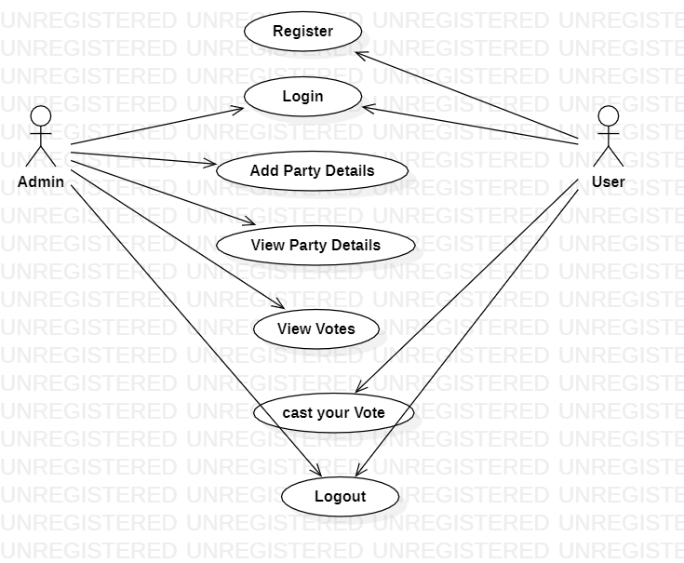
Use Case Diagram

Slide 26
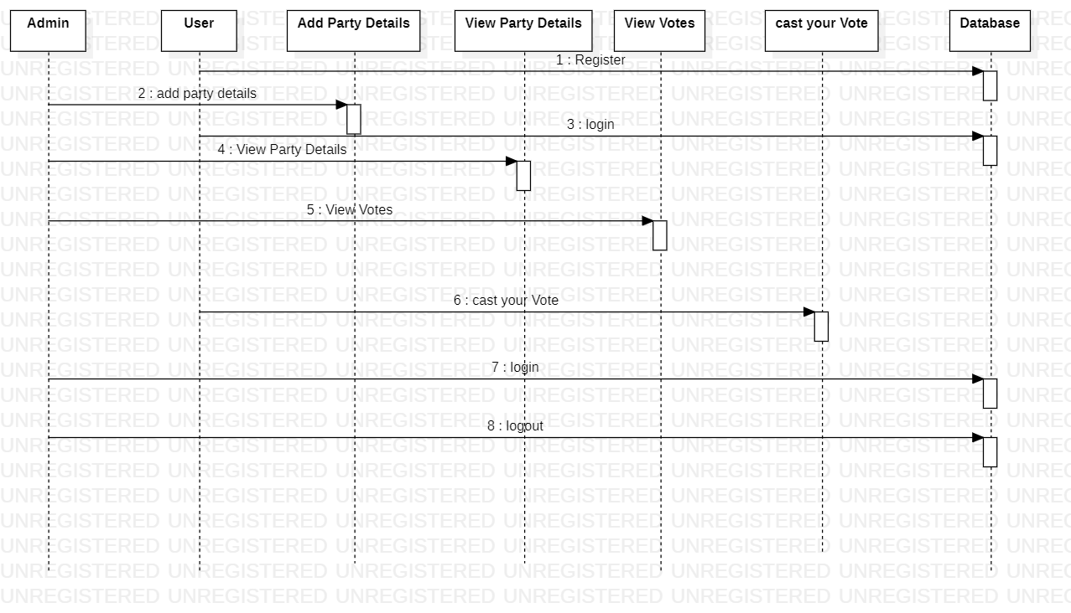
Sequence diagram

Slide 27
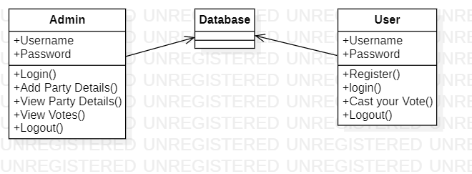
Class Diagram

Slide 28
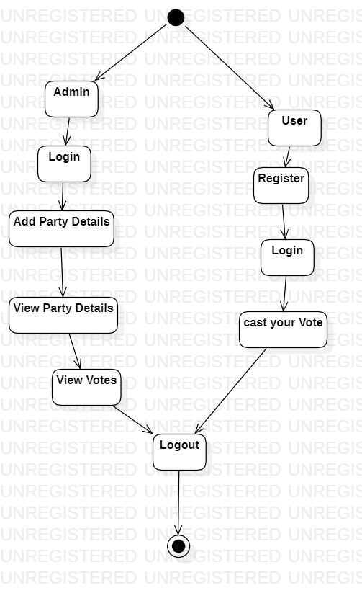
Activity Diagram

Slide 29
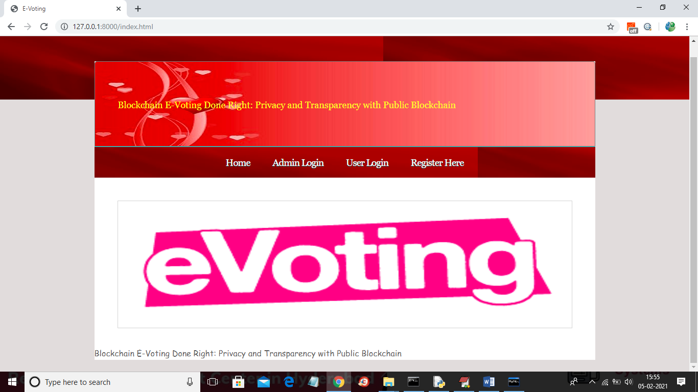
Input screen

Slide 30
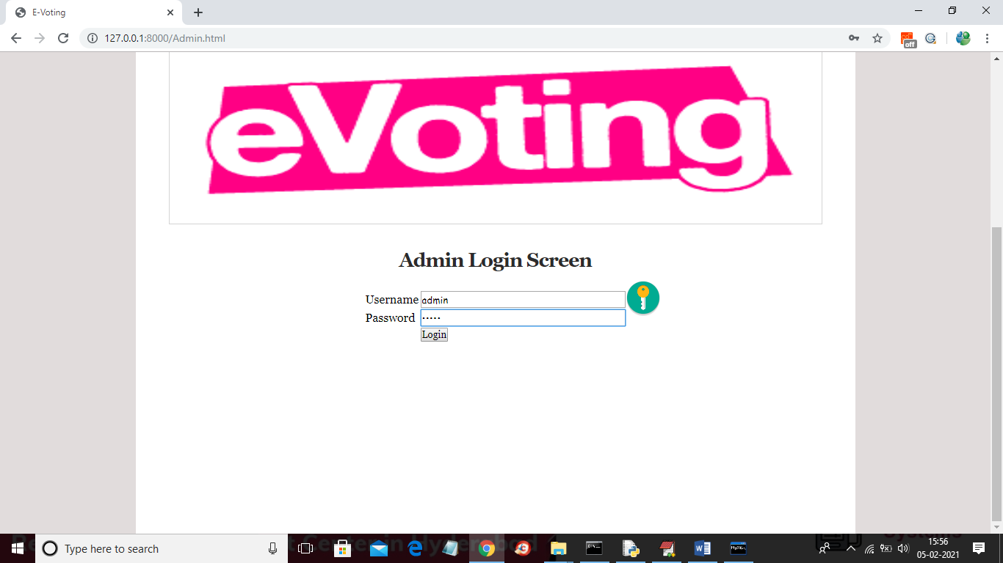
Analysis

Slide 31
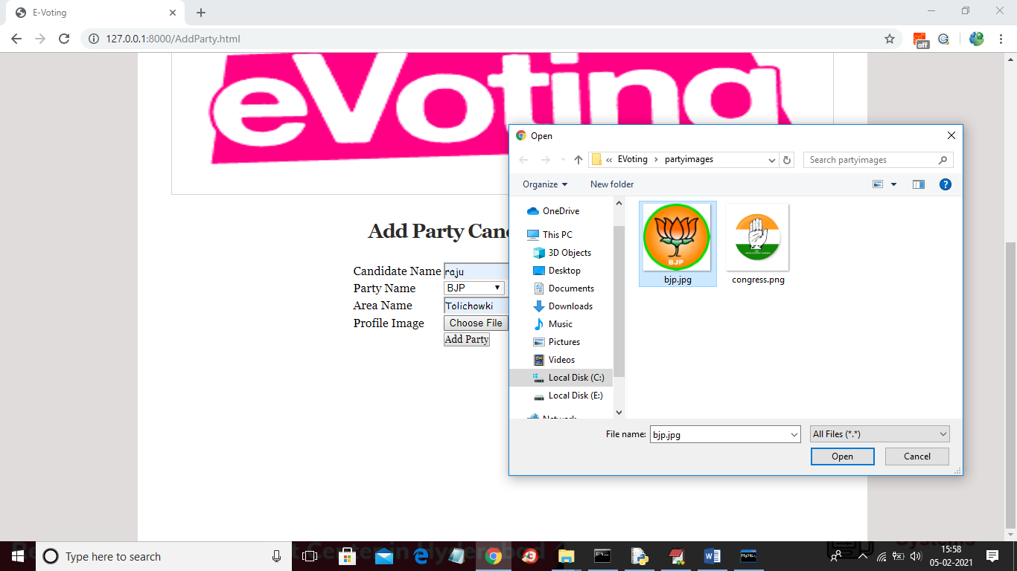

Slide 32
Test cases
Sl # Test Case : ­ | UTC­1
Name of Test: ­ | Admin add candidates
Items being tested: ­ | Candidates’ details update to database
Sample Input: ­ | Candidate details
Expected output: ­ | Details stored in database
Actual output: ­ | Stored and view by admin
Remarks: ­ | Pass.

Slide 33
Sl # Test Case : ­ | UTC­2
Name of Test: ­ | Add user
Items being tested: ­ | Verify user details added with face image
Sample Input: ­ | face image , user details
Expected output: ­ | Details stored in database and face image data extracted
Actual output: ­ | face image stored in db and user details view by admin
Remarks: ­ | pass

Slide 34
Sl # Test Case : ­ | ITC­1
Name of Test: ­ | User login
Item being tested: ­ | Login with face verify
Sample Input: ­ | face image and user name and password
Expected output: ­ | If images are same login verify block chain
Actual output: ­ | block chain verified
Remarks: ­ | Pass.

Slide 35
REFERENCES
[1] N. Kshetri and J. Voas, “Blockchain-Enabled E-Voting,”IEEE Software,vol. 35, pp. 95-99, jul 2018.
[2] M. Pawlak, J. Guziur, and A. Poniszewska-Mara nda, “Voting Processwith Blockchain Technology: Auditable Blockchain Voting System,” inLecture Notes on Data Engineering and Communications Technologies,pp. 233-244, Springer, Cham, 2019.
[3] B. Singhal, G. Dhameja, and P. S. Panda, “How Blockchain Works,” inBeginning Blockchain, pp. 31-148, Berkeley, CA: Apress, 2018.
[4] Agora, “Agora Whitepaper,” 2018.
[5] R. Perper, “ Sierra Leone is the first country to use blockchain duringan election - Business Insider,” 2018.
[6] S. Nakamoto, “Bitcoin: A Peer-to-Peer Electronic Cash System,” tech.rep., 2008.
[7] G. Wood et al., “Ethereum: A secure decentralised generalised transaction ledger,”Ethereum project yellow paper, vol. 151, pp. 1-32, 2014.

